Slide 1
Yummy
Food ordering Website

Slide 2
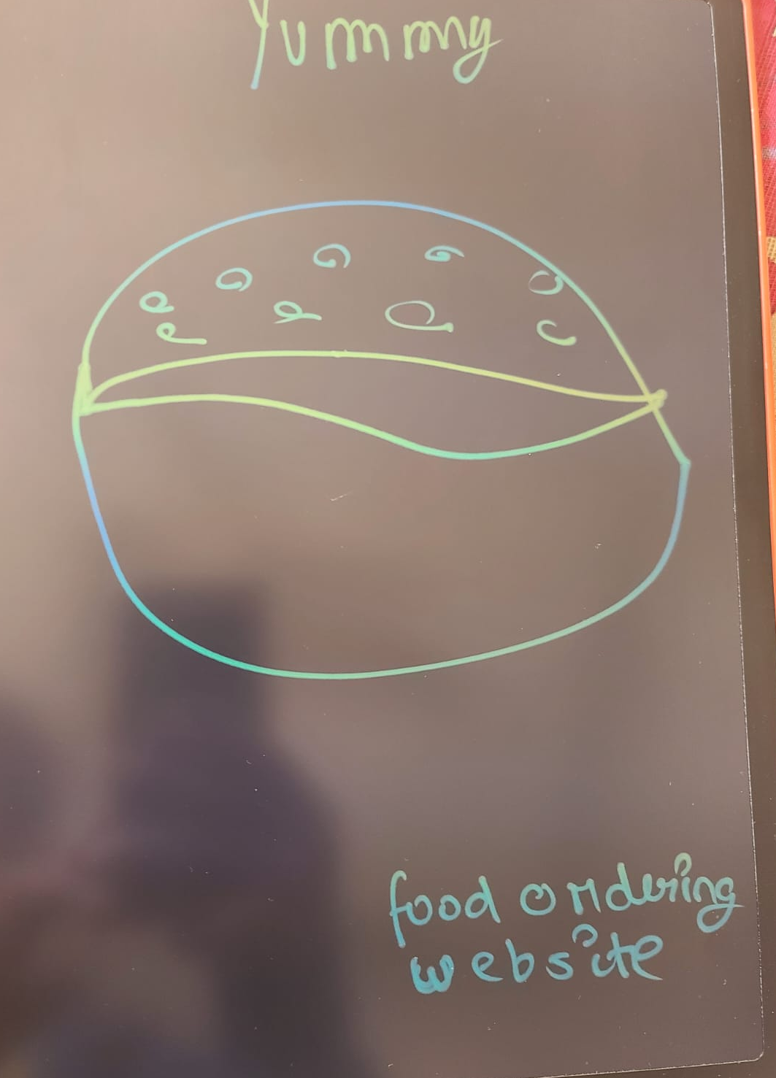
LOGO DESIGN

Slide 3


Slide 4
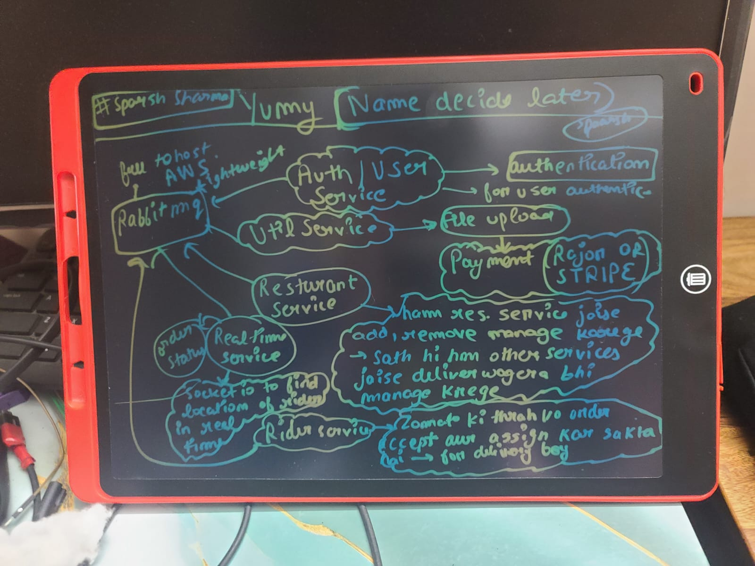
Systum Design

Slide 5
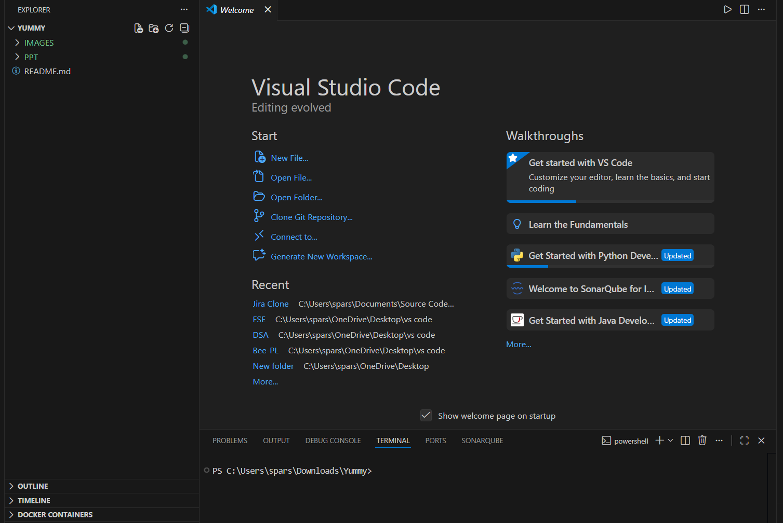
Now we are ready to start/……

Slide 6
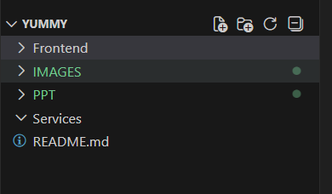
Frontend folder for
Frontend services
(React + Vite)

Slide 7
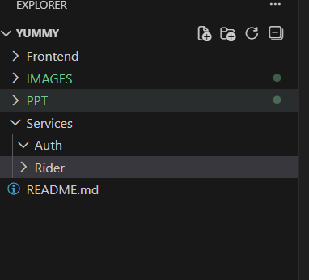

Slide 8
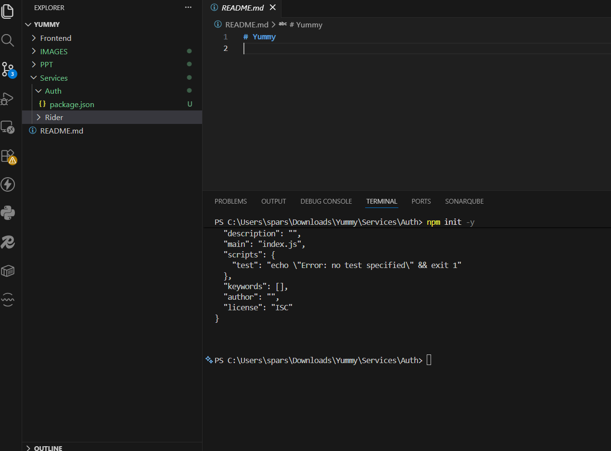
Project json file is installed using package.json..
We need a typescript file also..so for it..we gonna install typescript globally

Slide 9
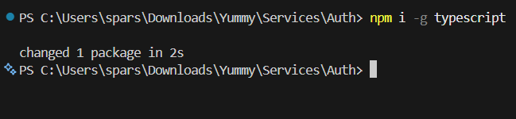
Install typescript globally

Slide 10
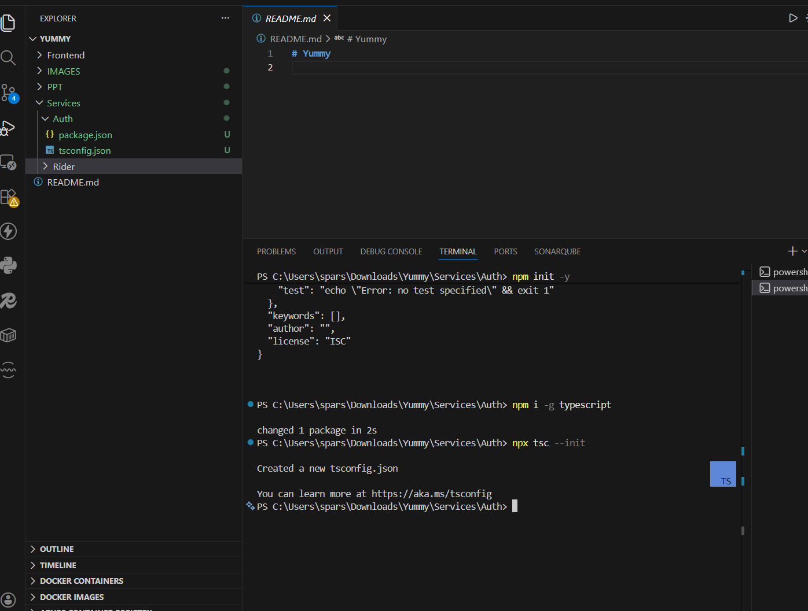

Slide 11
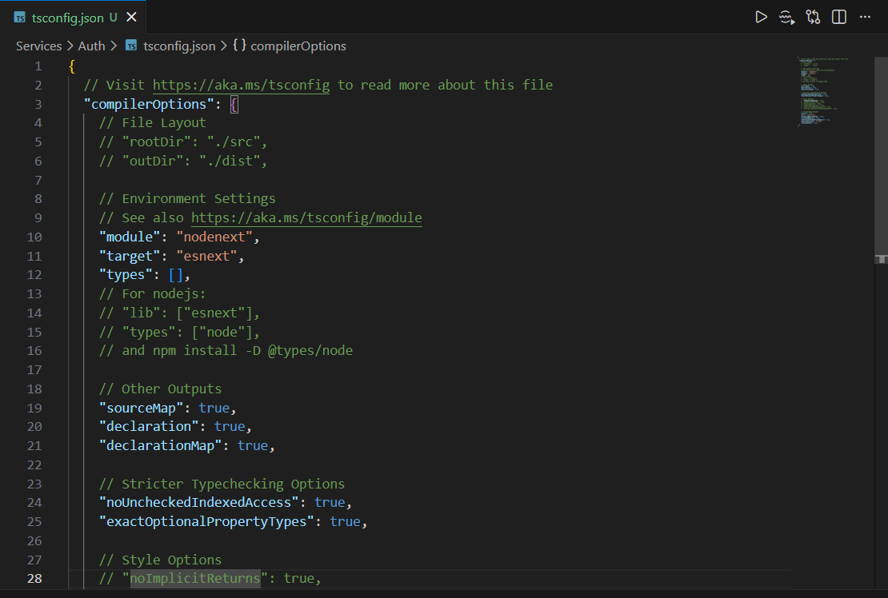

Slide 12
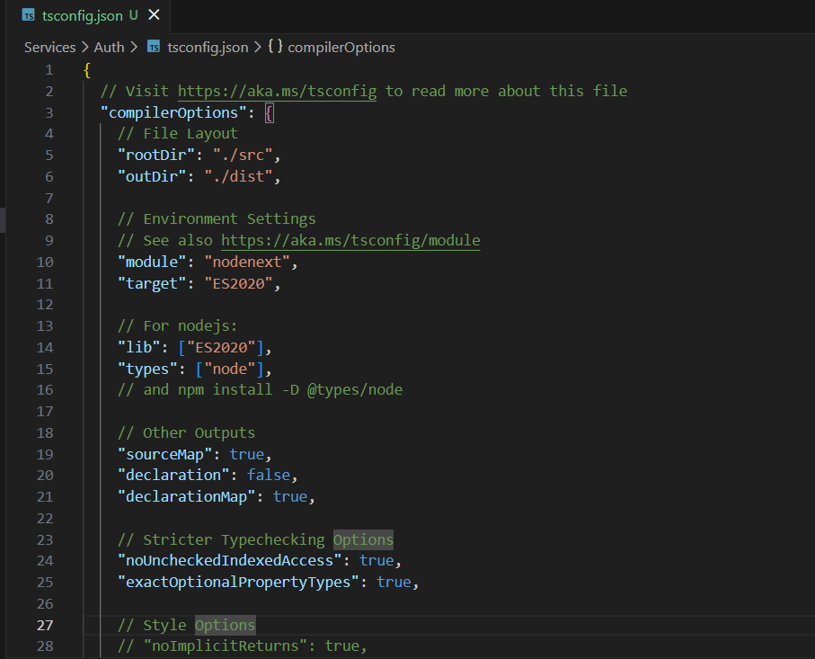

Slide 13
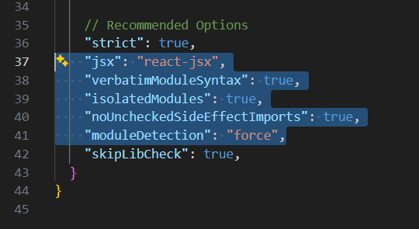
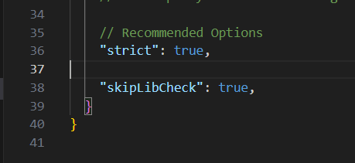

Slide 14
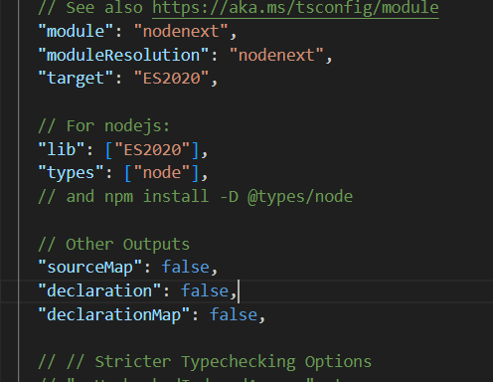

Slide 15
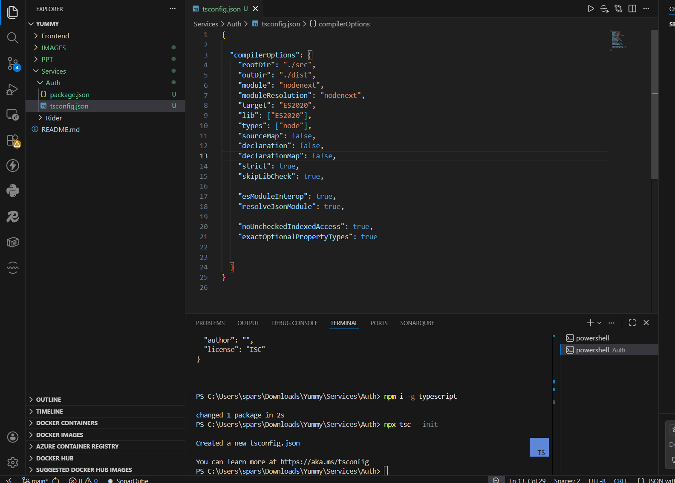

Slide 16
We do not need nodemon…we gonna use something different
Googleapis --- authentication

Slide 17
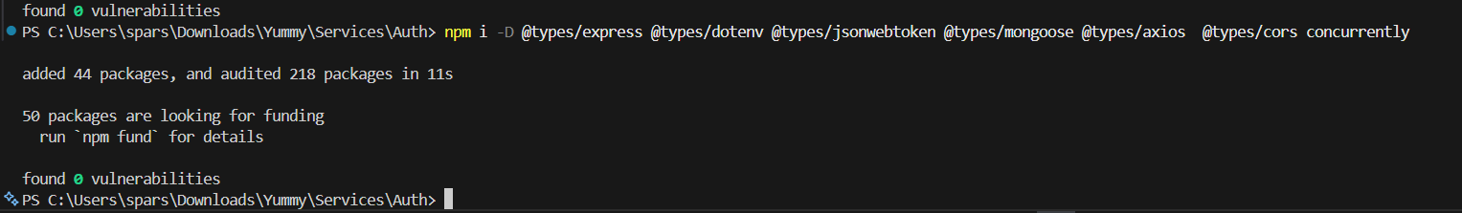
We gonna install these as dev depenedencies (so we use –D) which we use in development time
Concurrently : It helps us to run two tabs together

Slide 18
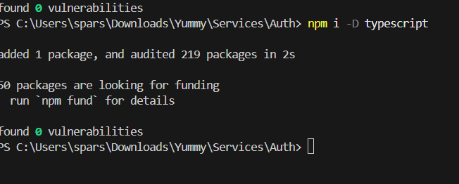

Slide 19
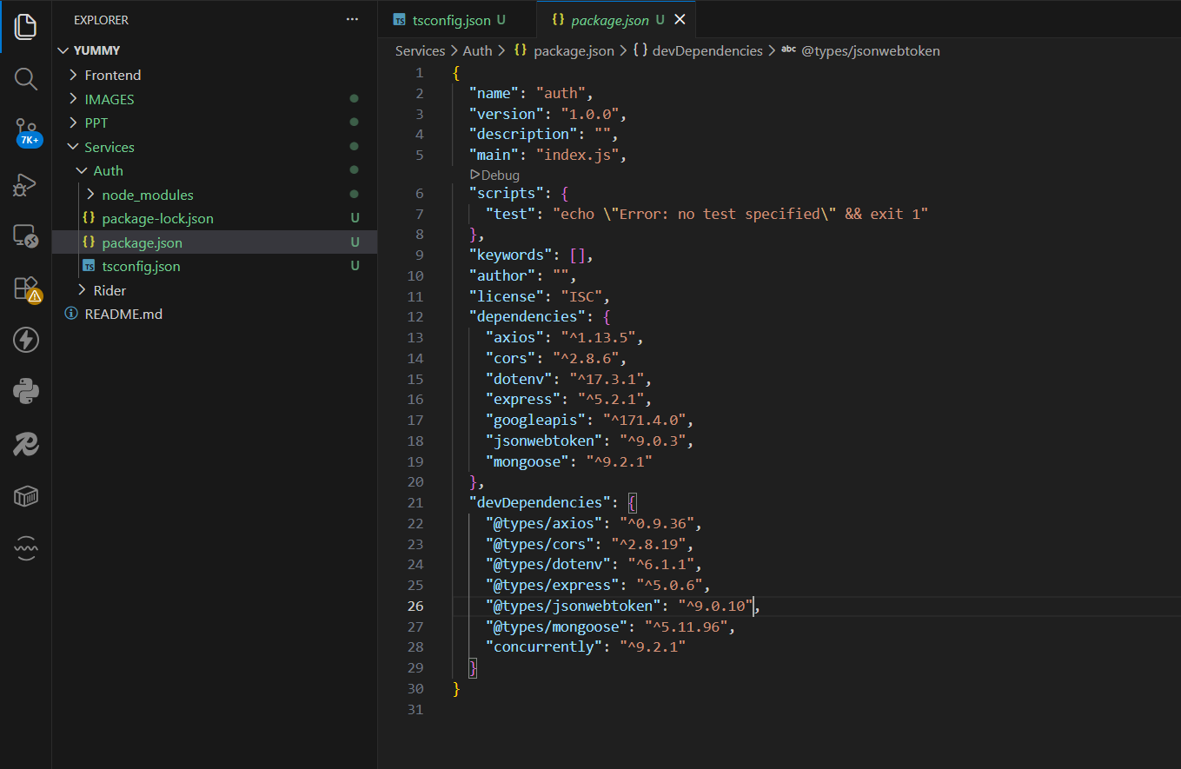
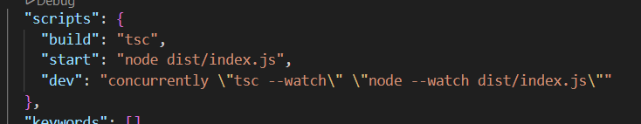

Slide 20
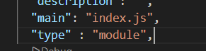
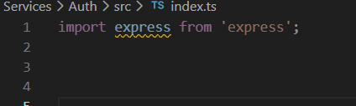
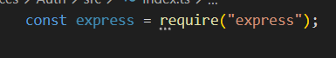
If we do type: module…then we can use ES6

Slide 21
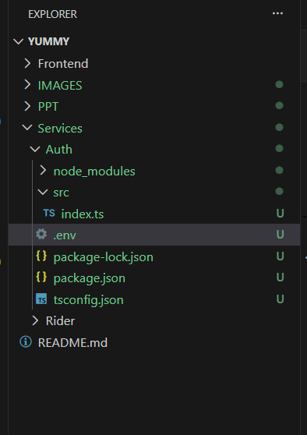

Slide 22
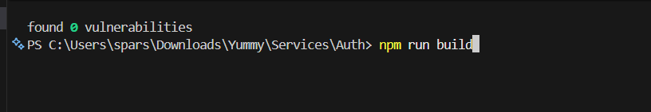

Slide 23
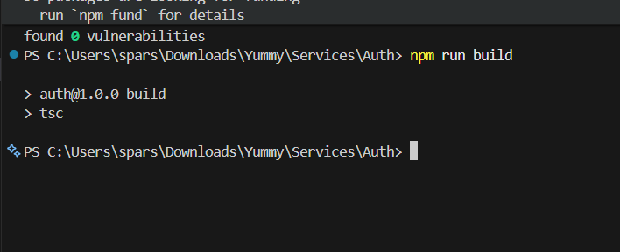
After this …we gonna see a dist folder inside the auth
The code which we have created in index.ts file..that same code we gonna see inside the dist folder in index.ts file
This is because we have done changes in the tsconfig file

Slide 24
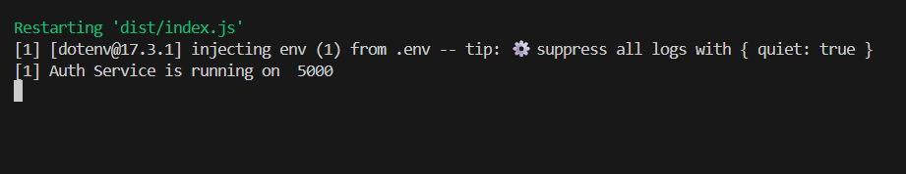
Npm run dev
Now without nodemon also …we can restart the folder and constantly watch over the changes
Without restarting the server

Slide 25
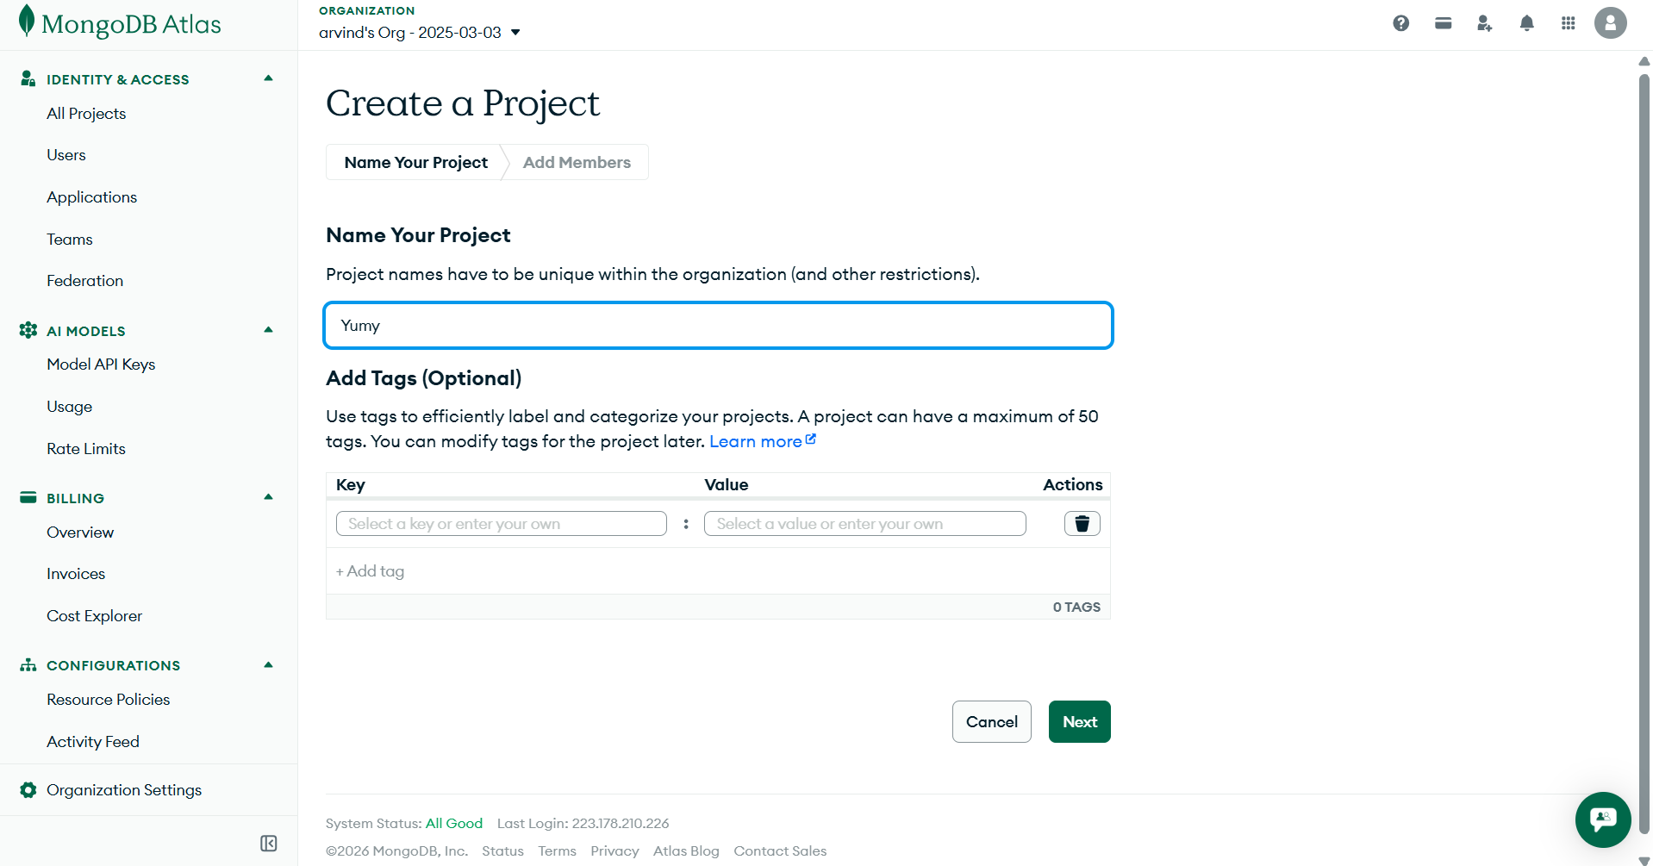

Slide 26
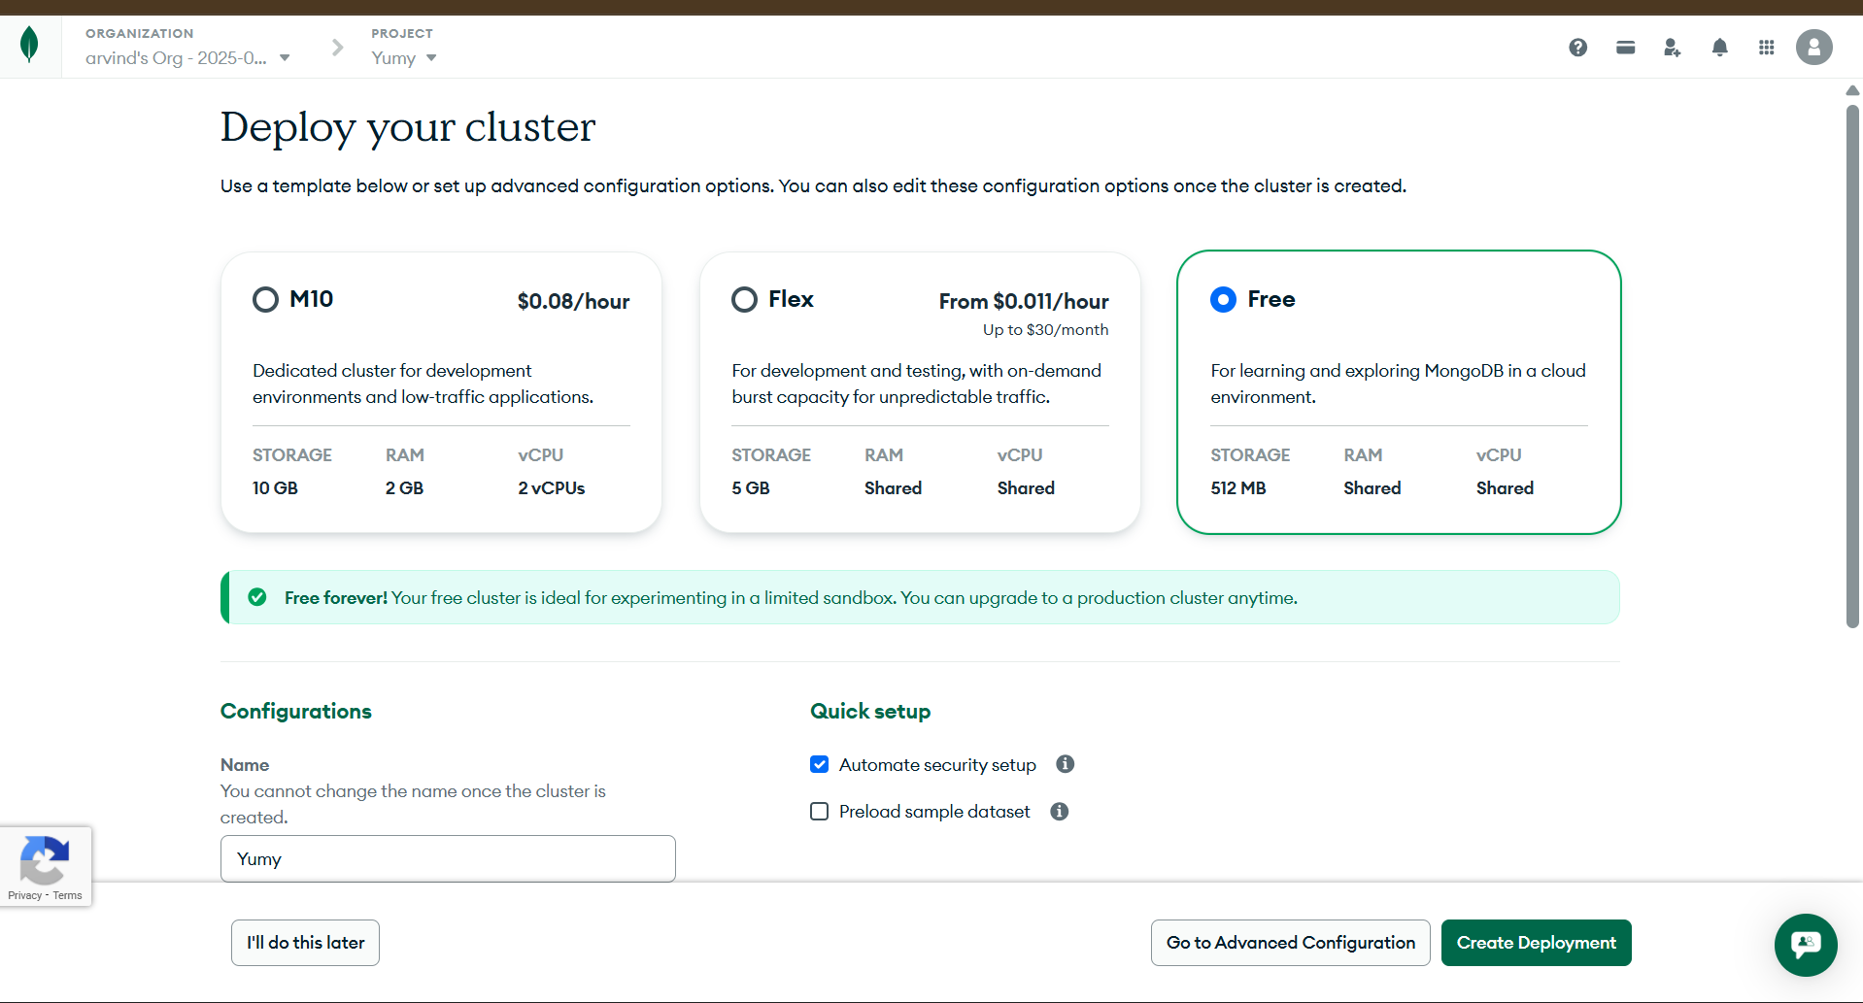

Slide 27
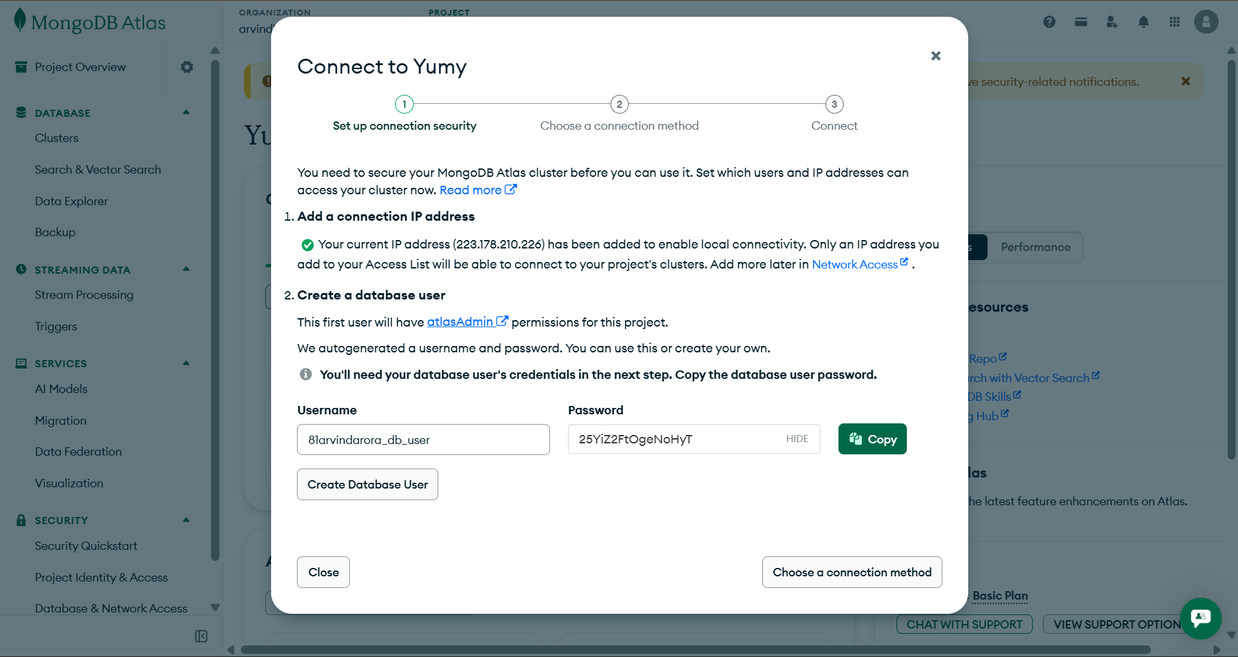

Slide 29
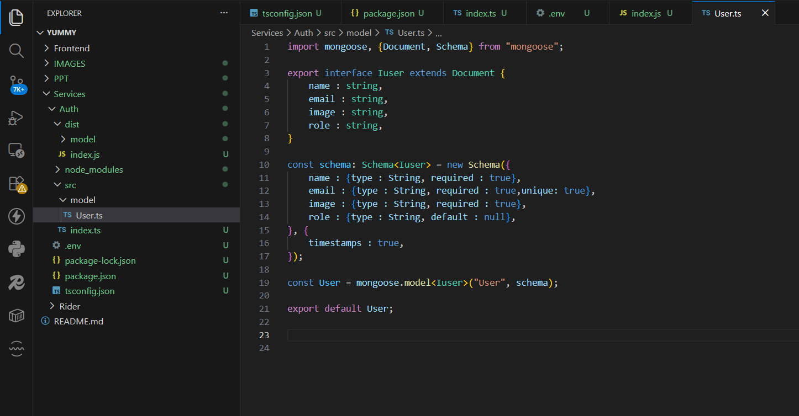
Now we gonna create one model inside the src

Slide 30
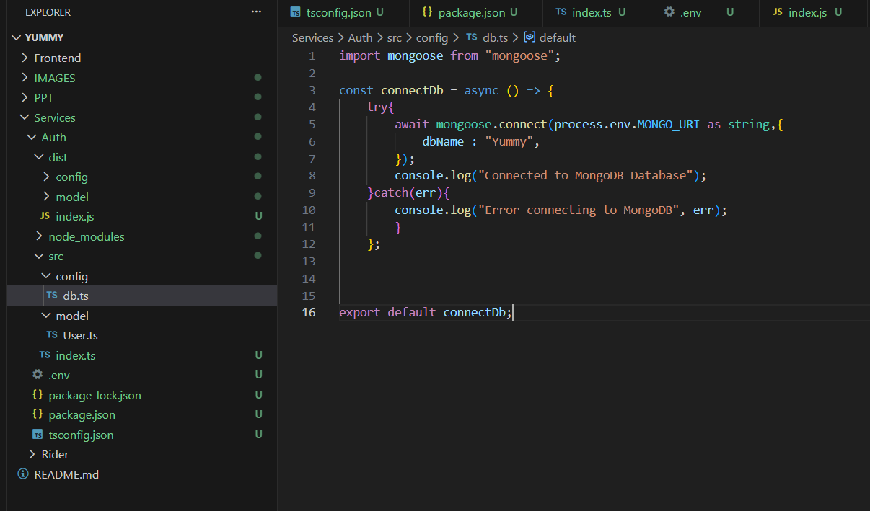
Now we have created the userSchema …its time to make the db connection working

Slide 31
Now we have completed the work….now we need mongouri
..so we go to the website and put the mongodb thing in env

Slide 32
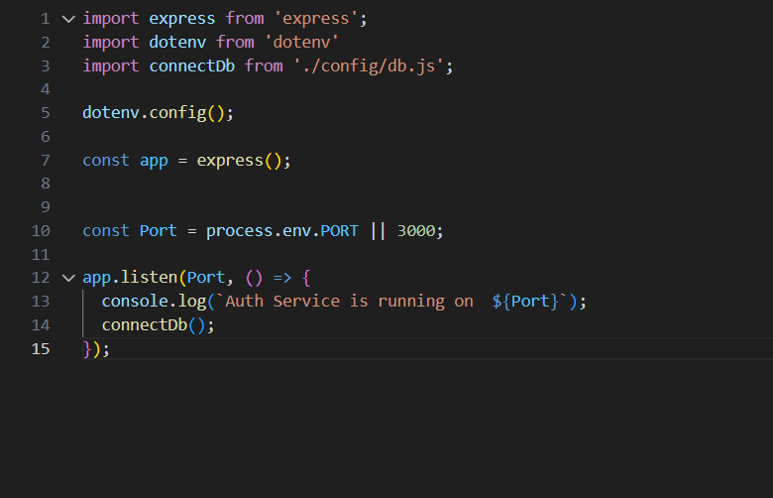
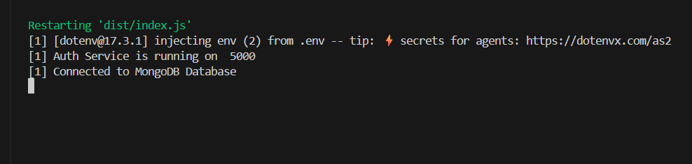
Here we have imported the connectdb and used it

Slide 33
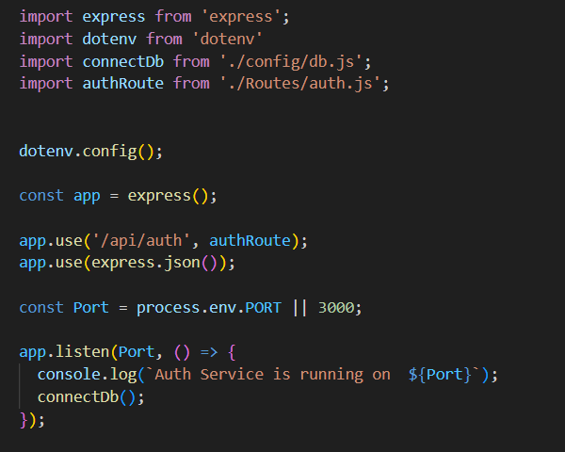
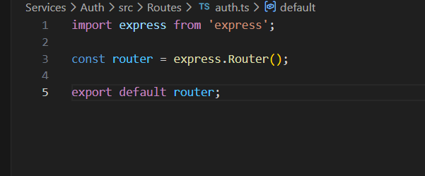

Slide 35
Now we gonna make controller

Slide 36
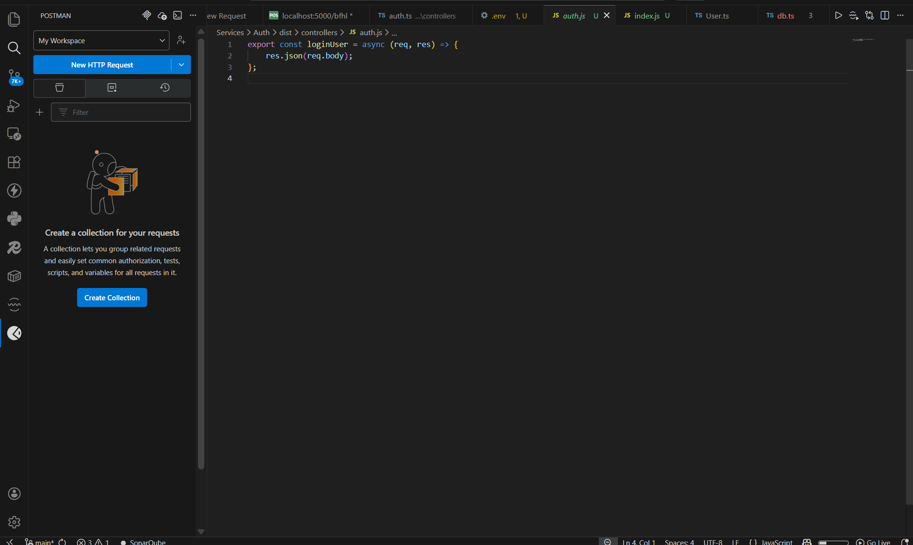
Now we gonna check the working on postman

Slide 37
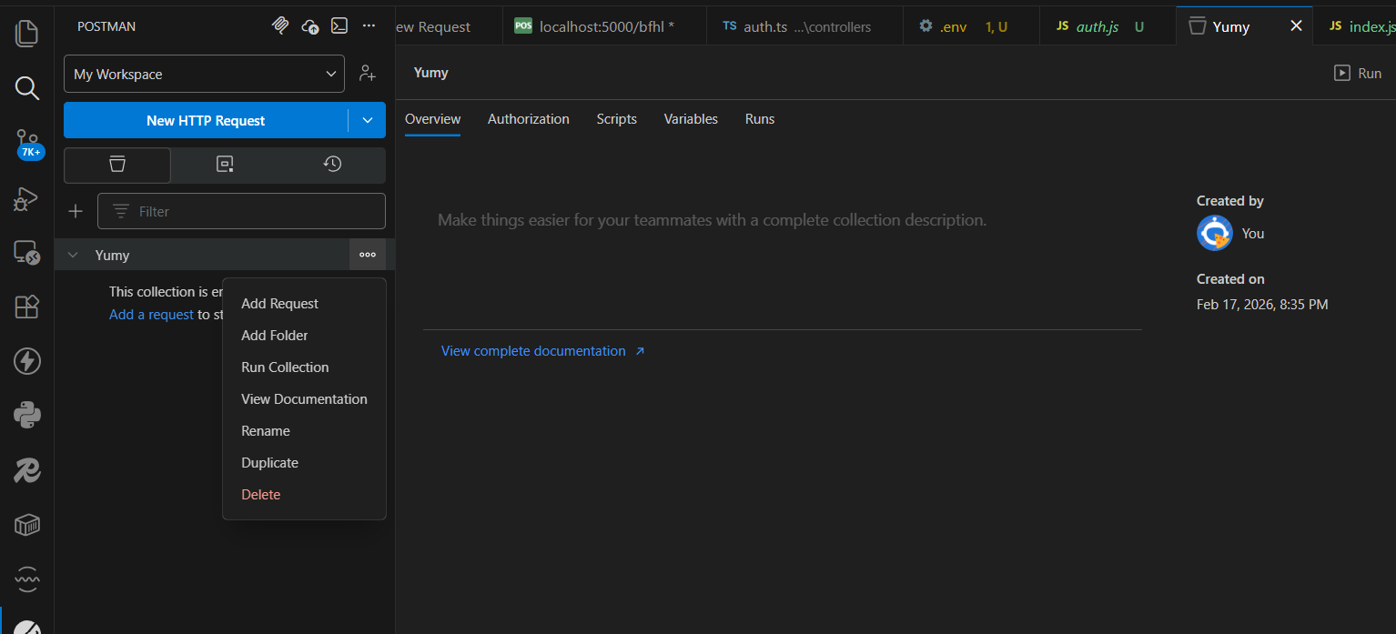

Slide 38
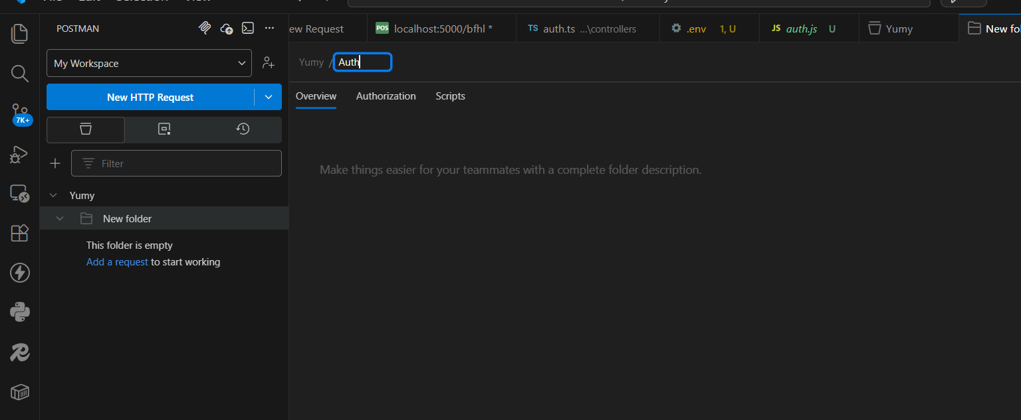
Now we create new folder and write Auth

Slide 39
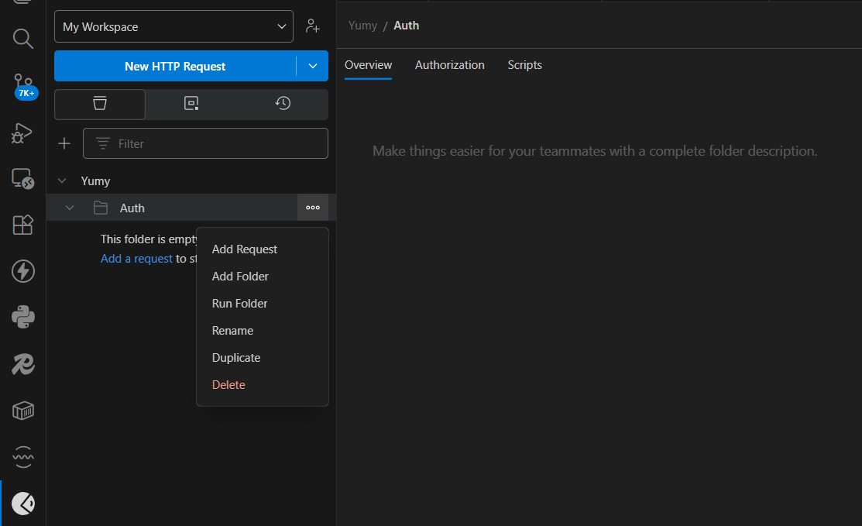
We gonna add request in that

Slide 40
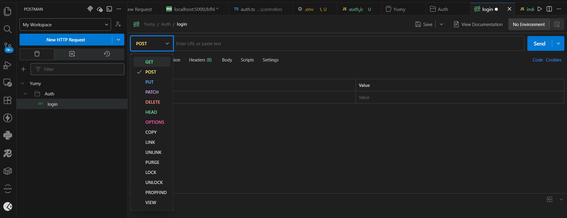
This login will be a post method

Slide 41
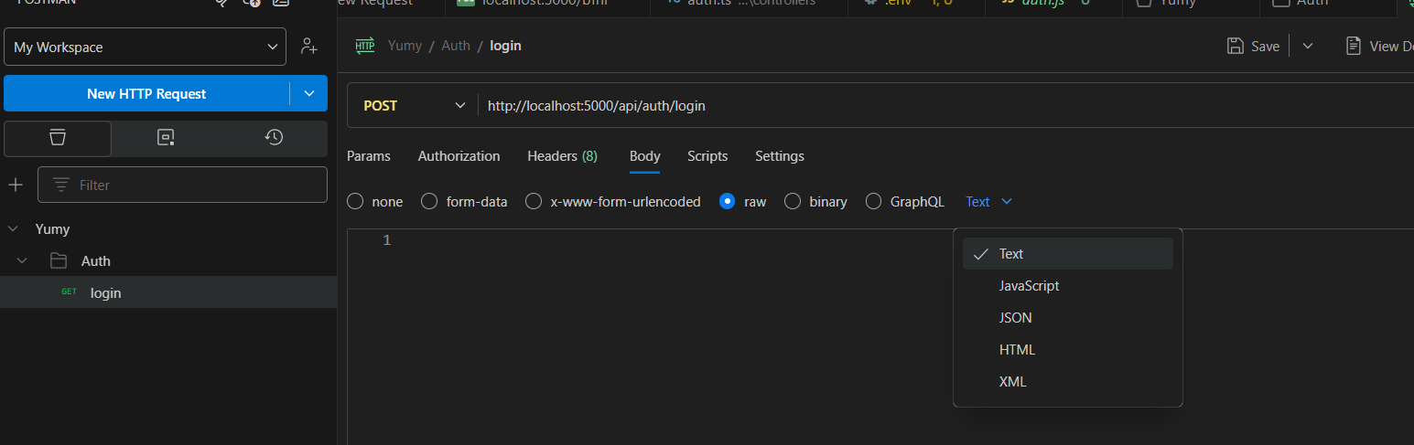
Now we gonna send a post request
We remove text and share json data,,,, we just go in body and choose raw data to share and in that
We will choose the json instead of text

Slide 43
Now after doing all..we gonna make routes and controller

Slide 44
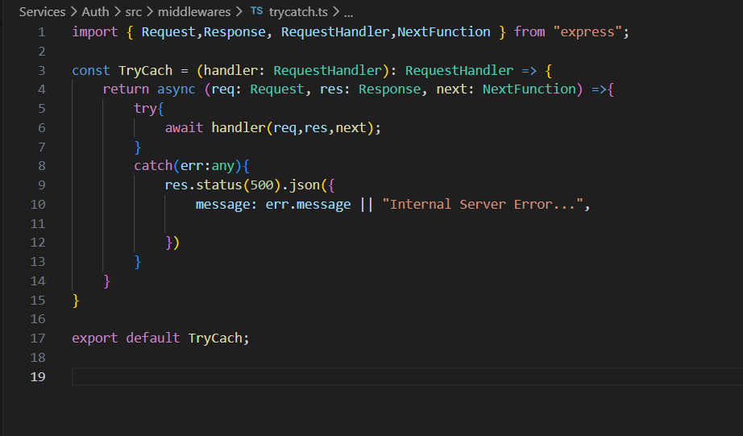
Middleware
Next thing which we will make is middleware folder
Basically we are using the try-catch everywhere..so in order to follow the DRY principle..we will simply create it in middleware folder and use it

Slide 45
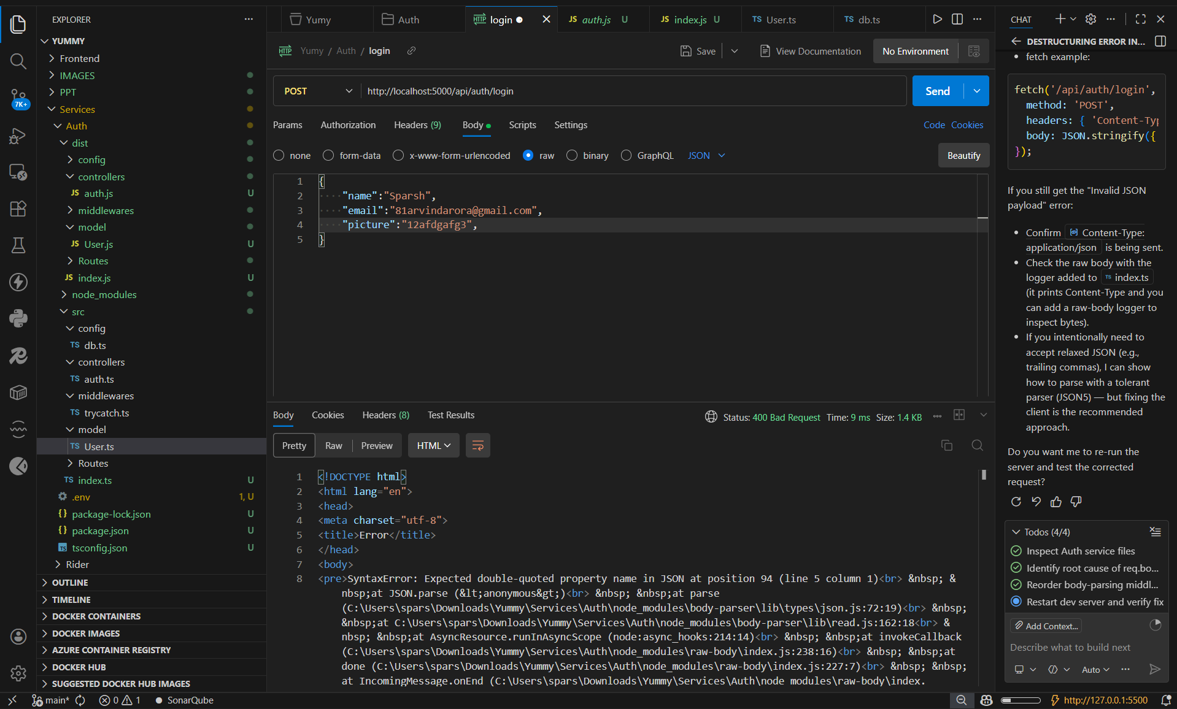

Slide 46
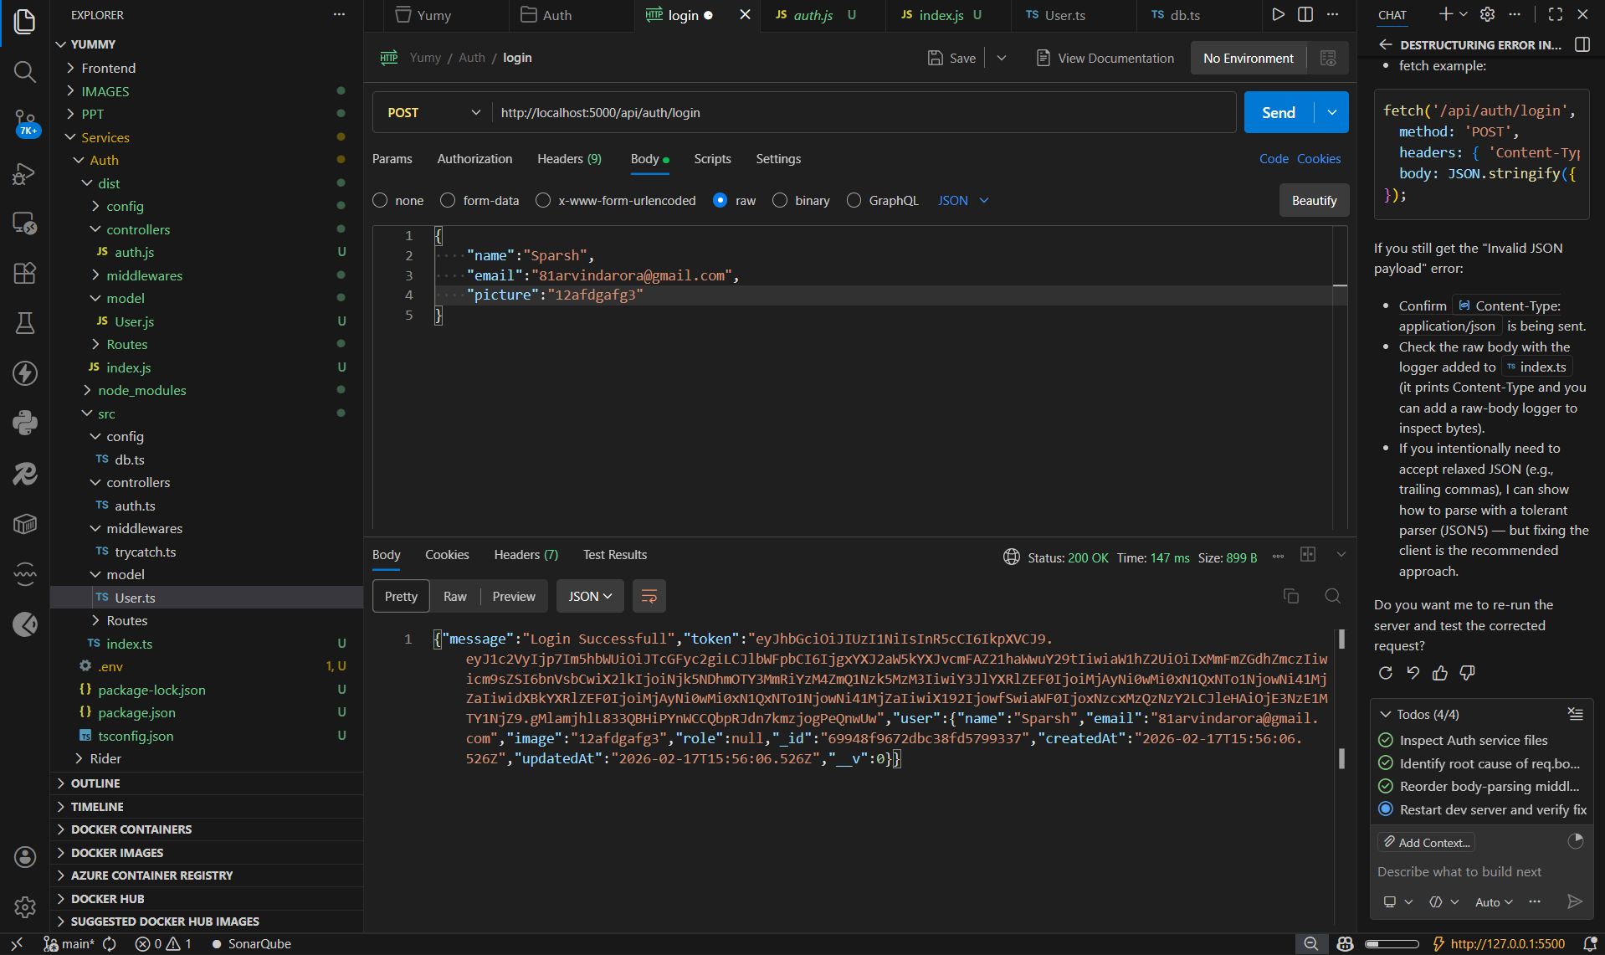

Slide 47
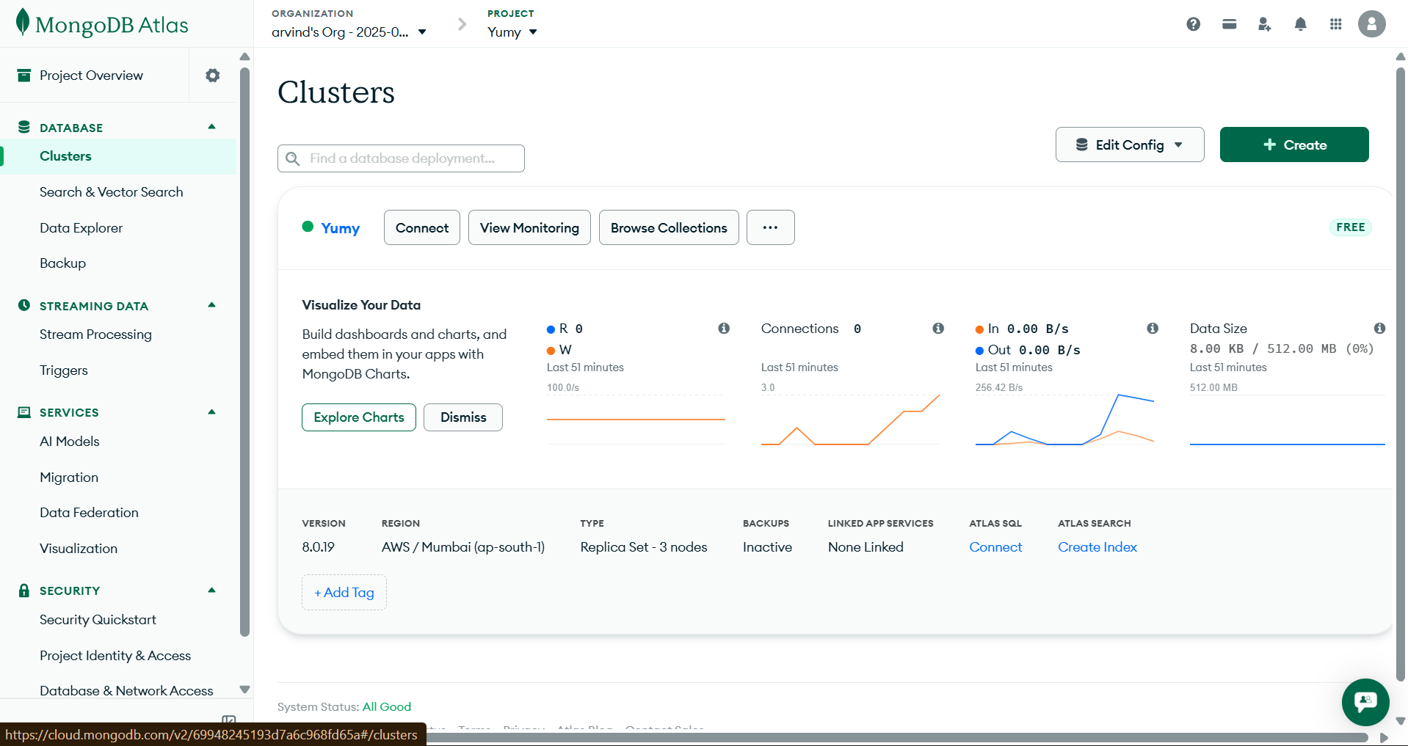

Slide 48
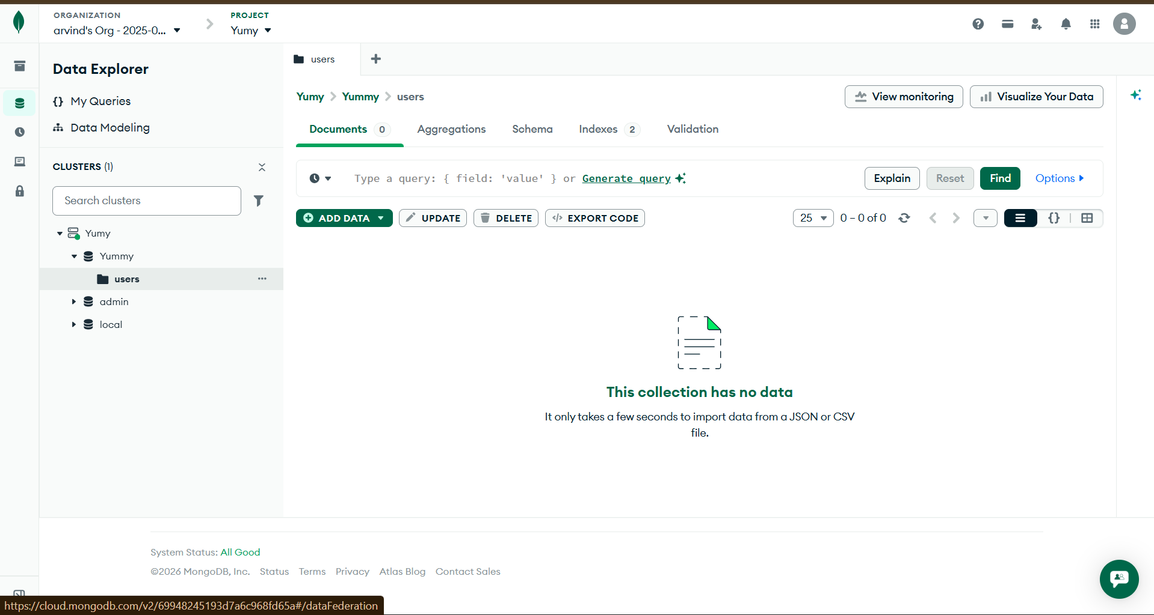
Our database

Slide 49
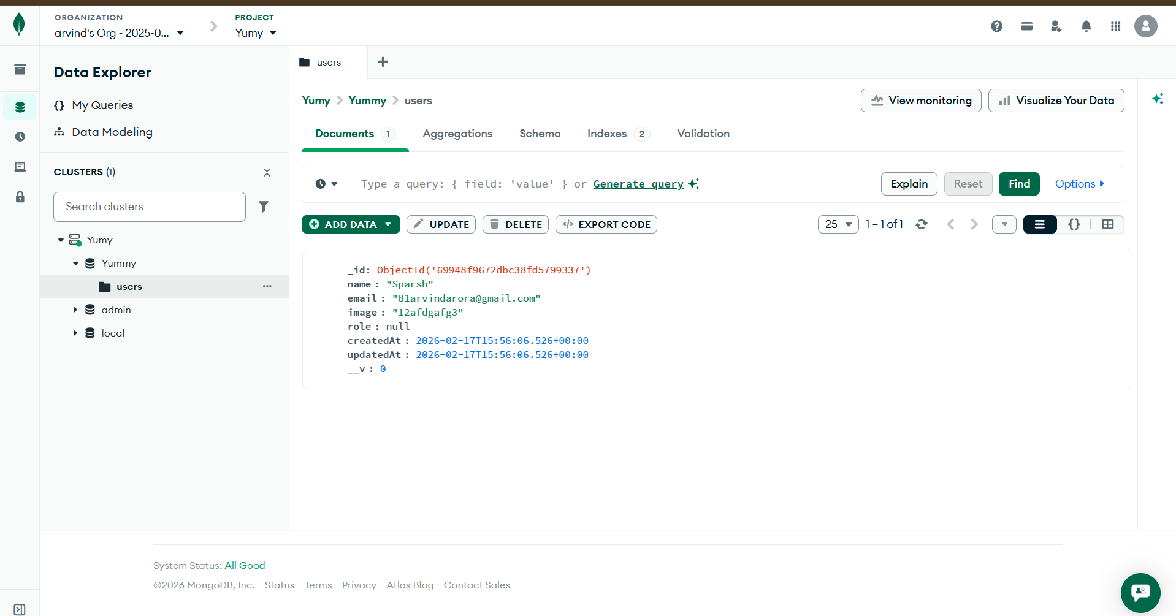
Data added in our database

Slide 50
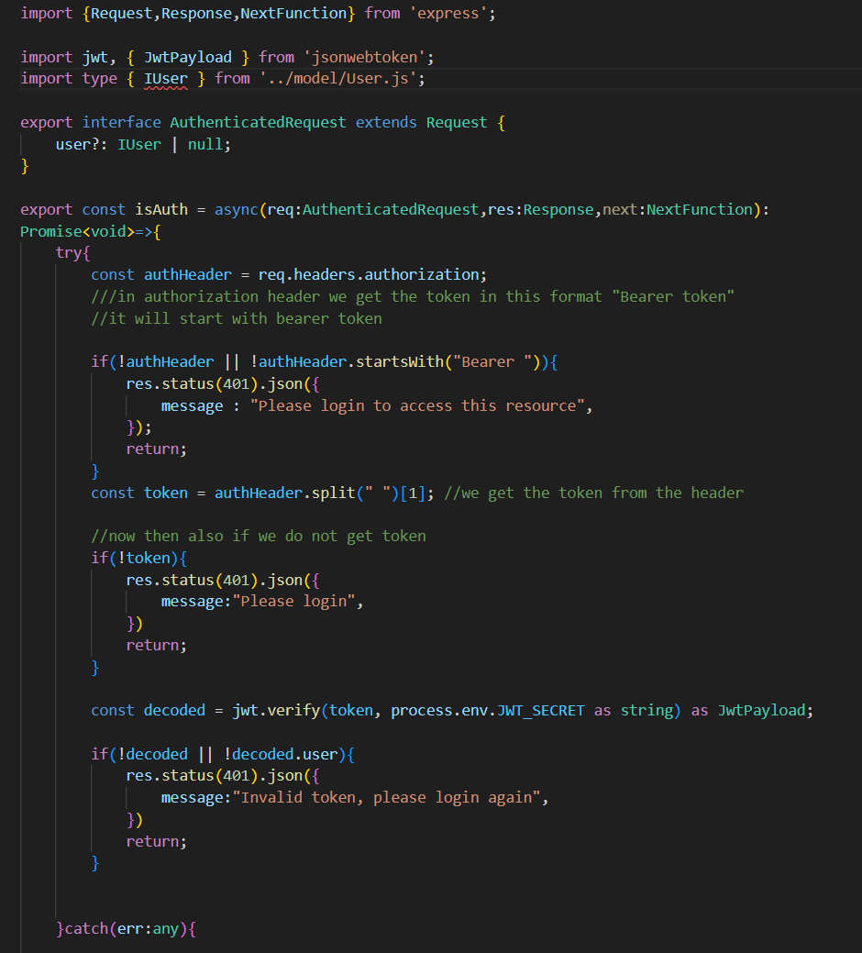
Now we gonna create authenticated middleware

Slide 51
Now we will give the permission of selecting the role to the user

